Slide 1
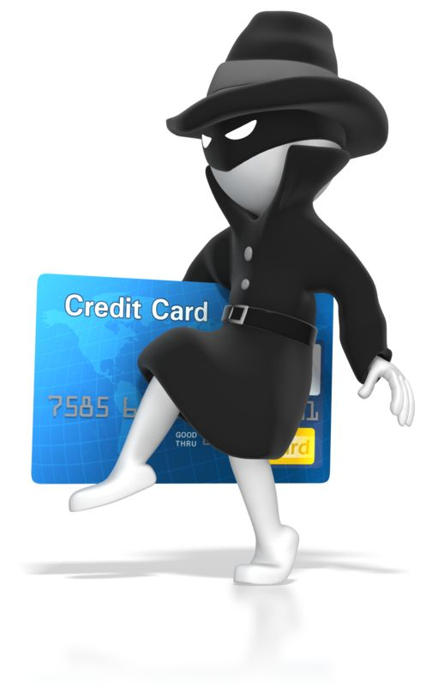
Combatting Credit Card Fraud: Data Analytics Solutions for Financial Security
By
Vrushali Rane
Video Link:
https://drive.google.com/file/d/1jIpJ-cSCPVKEvhsOYfXsswv3zBtBzDsO/view?usp=drive_link

Slide 2


AGENDA
Objective
Background
Problem solving approach
Key insights
Cost benefit analysis
Business recommendations

Slide 3
OBJECTIVE
Develop a machine learning model for detecting fraudulent transactions.
Utilize historical transactional data to train the machine learning model.
Analyse the business impact of fraudulent transactions on the bank.
Perform a cost-benefit analysis of the fraud detection model.
Recommend optimal strategies for mitigating fraud risks based on the model's insights.

Slide 4
BACKGROUND
Finex is a prominent financial service provider based in Florida, US, offers various products and services across
multiple channels, ranging from in-person banking and ATMs to online banking
Observations reveal a significant surge in unauthorized transactions, leading to revenue and profitability crises.
Customers report unauthorized transactions, indicating the exploitation of stolen/lost cards and hacked systems by fraudsters.
Fraudulent activities include ATM skimming, particularly at terminals lacking security measures.
Customers often detect unauthorized transactions late, leading to delayed complaints and heavy losses for Finex.
Finex's outdated technology hampers timely detection of data breaches, prompting the Branch Manager to seek root causes
and develop long-term solutions for revenue maximization and loss minimization.

Slide 5

PROBLEM SOLVING APPROACH
Understanding Data
Exploratory data analytics (EDA)
Train/Test Data Splitting
Model Building or Hyperparameter Tuning
Model Evaluation
Business Impact

Slide 6
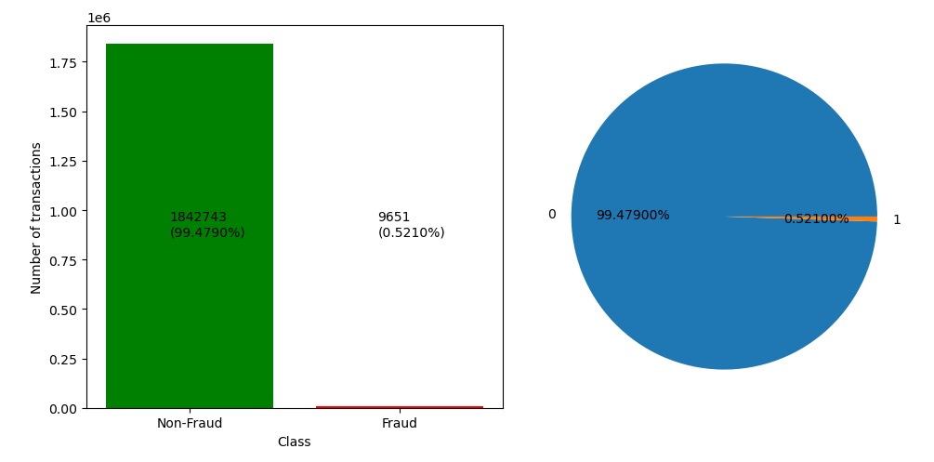
KEY INSIGHTS
The dataset comprises 1,852,394 transactions, among which 9,651 are identified as fraudulent.
This dataset exhibits a significant class imbalance, with fraudulent transactions representing only 0.52% of the total transactions.

Slide 7
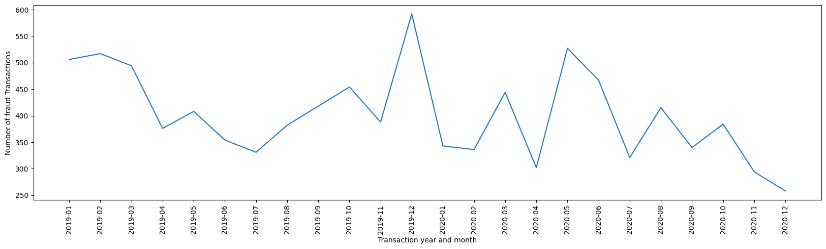
KEY INSIGHTS
Based on the data, the highest number of fraudulent transactions occurred in December 2019.

Slide 8
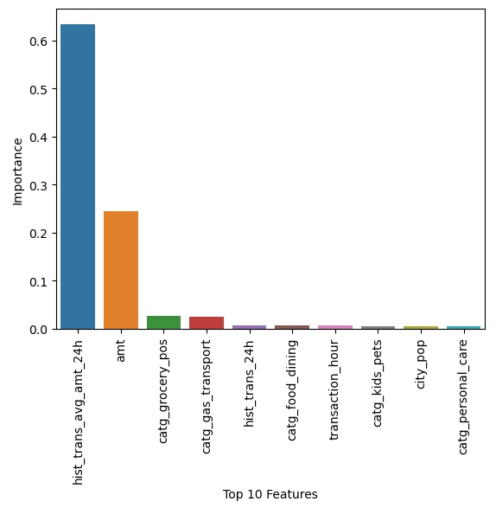
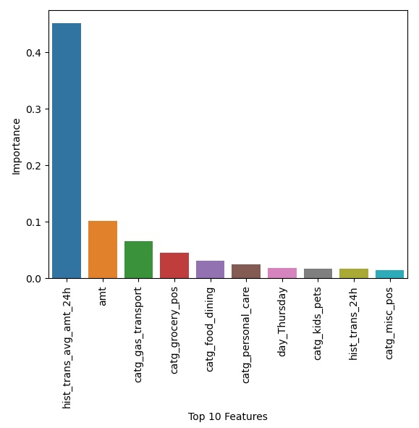
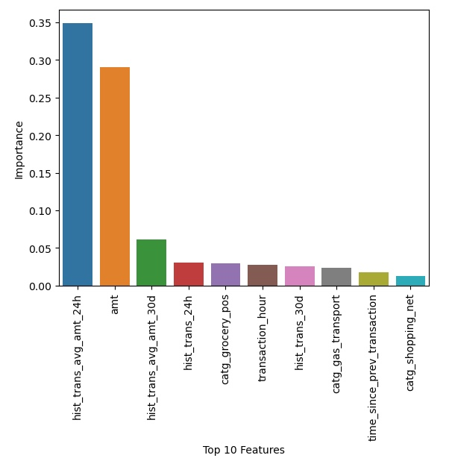
KEY INSIGHTS
Decision Tree Model
Random Forest Model
XGBoost Model
Based on the models with Hyperparameter Tuning using SMOTE data, these are top 10 features that will help us identify fraudulent transactions.

Slide 9
COST BENEFIT ANALYSIS
Cost Benefit Analysis before model building
S. No | Questions | Answer
a | Average number of transactions per month | 77183
b | Average number of fraudulent transaction per month | 403
c | Average amount per fraud transaction | 531
Cost Benefit Analysis before model building
S. No | Questions | Answer
1 | Cost incurred per month before the model was deployed (b*c) | 213392
2 | Average number of transactions per month detected as fraudulent by the model (TF) | 399
3 | Cost of providing customer executive support per fraudulent transaction detected by the model | $1.5
4 | Total cost of providing customer support per month for fraudulent transactions detected by the model (TF*$1.5) | $598
5 | Average number of transactions per month that are fraudulent but not detected by the model (FN) | 13
6 | Cost incurred due to fraudulent transactions left undetected by the model (FN*c) | $6899
7 | Cost incurred per month after the model is built and deployed (4+6) | $7497
8 | Final savings = Cost incurred before - Cost incurred after(1-7) | $205895

Slide 10
BUSINESS RECOMENDATIONS
Implement SMS alerts for customers when spending significantly exceeds their historical average, based on
observed patterns in hist_trans_avg_amt_24h and hist_trans_avg_amt_30d.
Promptly notify customers via alerts of unusually high transaction amounts compared to their regular spending
patterns to mitigate fraud risks.
Exercise increased scrutiny and monitoring on specific cities with high population and need to be extra cautious
and high alert on this specific days to avoid fraudulent transactions.
Utilize flash SMS alerts to inform customers about transactions in high-risk categories like home-related expenses,
shopping, groceries, health and fitness, and gas and transportation.
Deploy SMS alerts during late night and early morning hours (between 22:00 and 03:00) to notify customers of
potentially fraudulent activity occurring during these periods.

